Slide 1

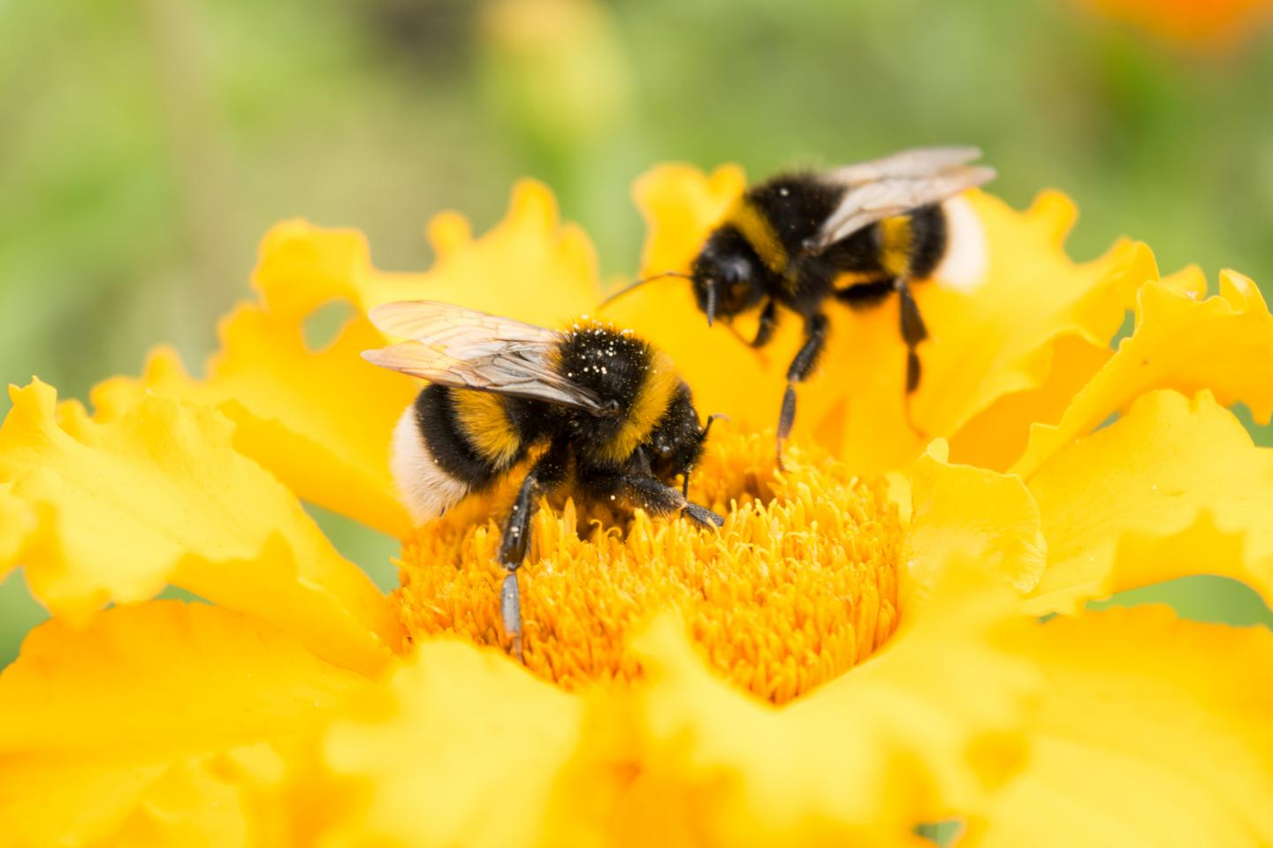
Optimal Delivery Routes Inspired by Bees’ “Waggle Dance”
Team Member: Bingqing Xiang
Feiyao Li
Wenjie Chen

Slide 2
Table of Content
Scientific motivation
Challenges
Background
Bees in Nature
Method
Bees Algorithm
Experiment Result
Conclusion
Reference

Slide 3
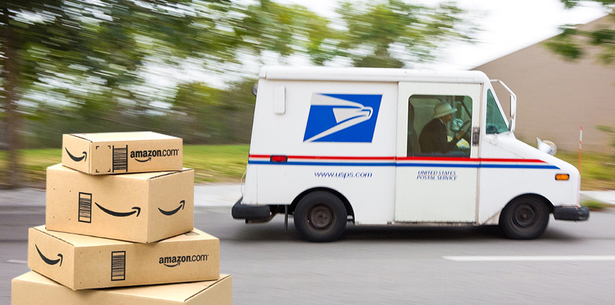
Scientific motivation
Problem
The increase of online shopping demand -- an optimal delivery route needed
Disaster assistance response team -- an optimal rescue plan in a short time.
Create a travel plan -- an optimal route to save time and money
Basically, it is traveling salesman problem
Brute force method
Depth First Search: n! path(n cites)
Goal
Use bees algorithm to optimize the best route

Slide 4
Challenges
The Problem is hard
NP-hard problem -- can’t be solved in polynomial time.
Hard to evaluate the performance
How to set the stop condition
Performance of algorithm is random
Real world data is large and dynamic

Slide 5
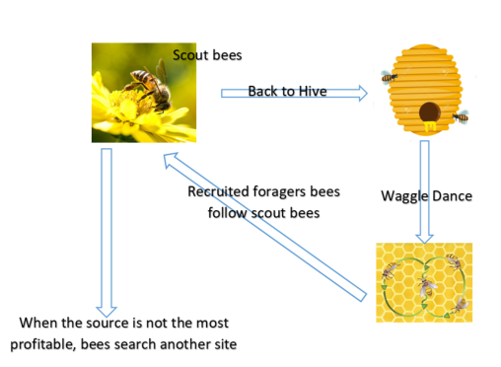
Background
Bee In Nature
the behaviors of foraging the food, based on the distance and the high quality of flower patch

Slide 6
Method--Bees Algorithm
Swarm-based optimisation algorithms(SOAs)
SOAs--a population of solutions for every iteration
Direct Search Algorithm -- a single solution
A population-based search algorithm that mimic the food foraging of honey bees
Expect to converge to single or multiple optimal solutions
Combine global search and neighborhood search
A solution like a flower; an agent like a bee that search one solution; compare a profitability
Able to find solutions close to the optimum

Slide 7
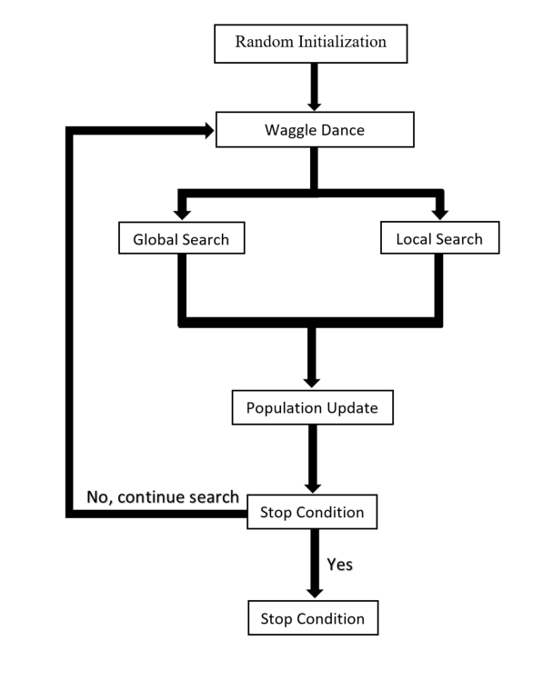
Method--Bees Algorithm
A Flowchart of Algorithm
Main Bees Algorithm Parameters
ns = number of scout bees
ne = number of elite sites
nb = number of best sites
nre = recruited bees for elite sites
nrb = recruited bees for remaining best sites

Slide 8
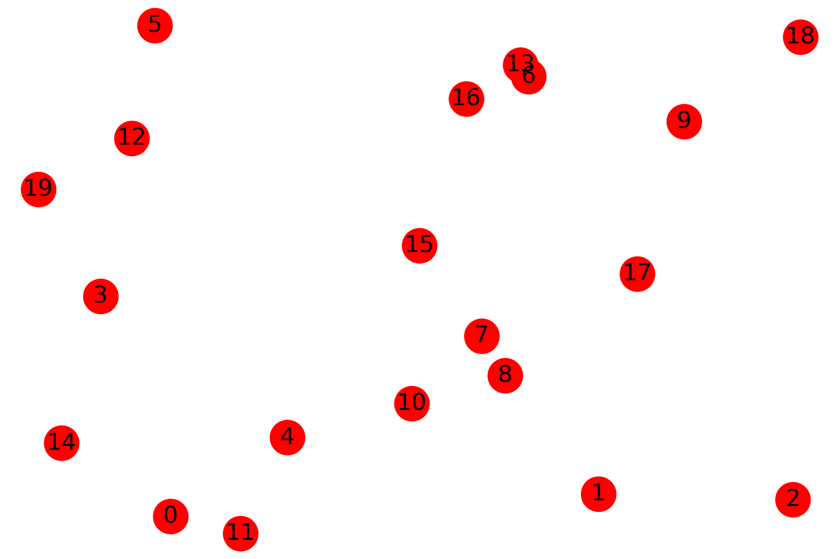
Experiment 1 Data
Random Generated Graph
nodes represent cities
number of cities
nc = 20
ns = 400
ne = int(ns * 0.25)
nre = 3
nb = int(ns * 0.3)
nrb = 1
max_epochs =5000
20!=2.433e+18

Slide 9
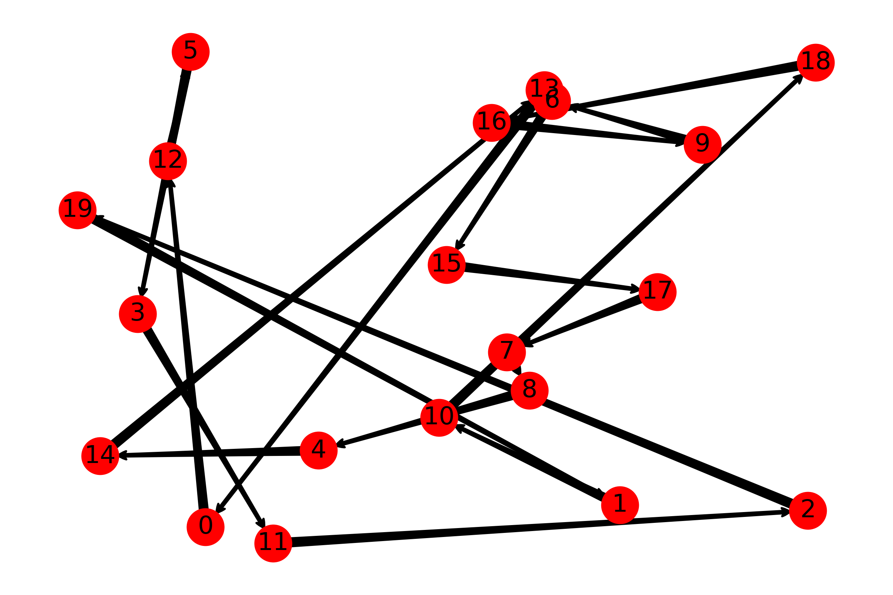
Experiment 1 Result
Epoch: 0
Distance:940.51

Slide 10
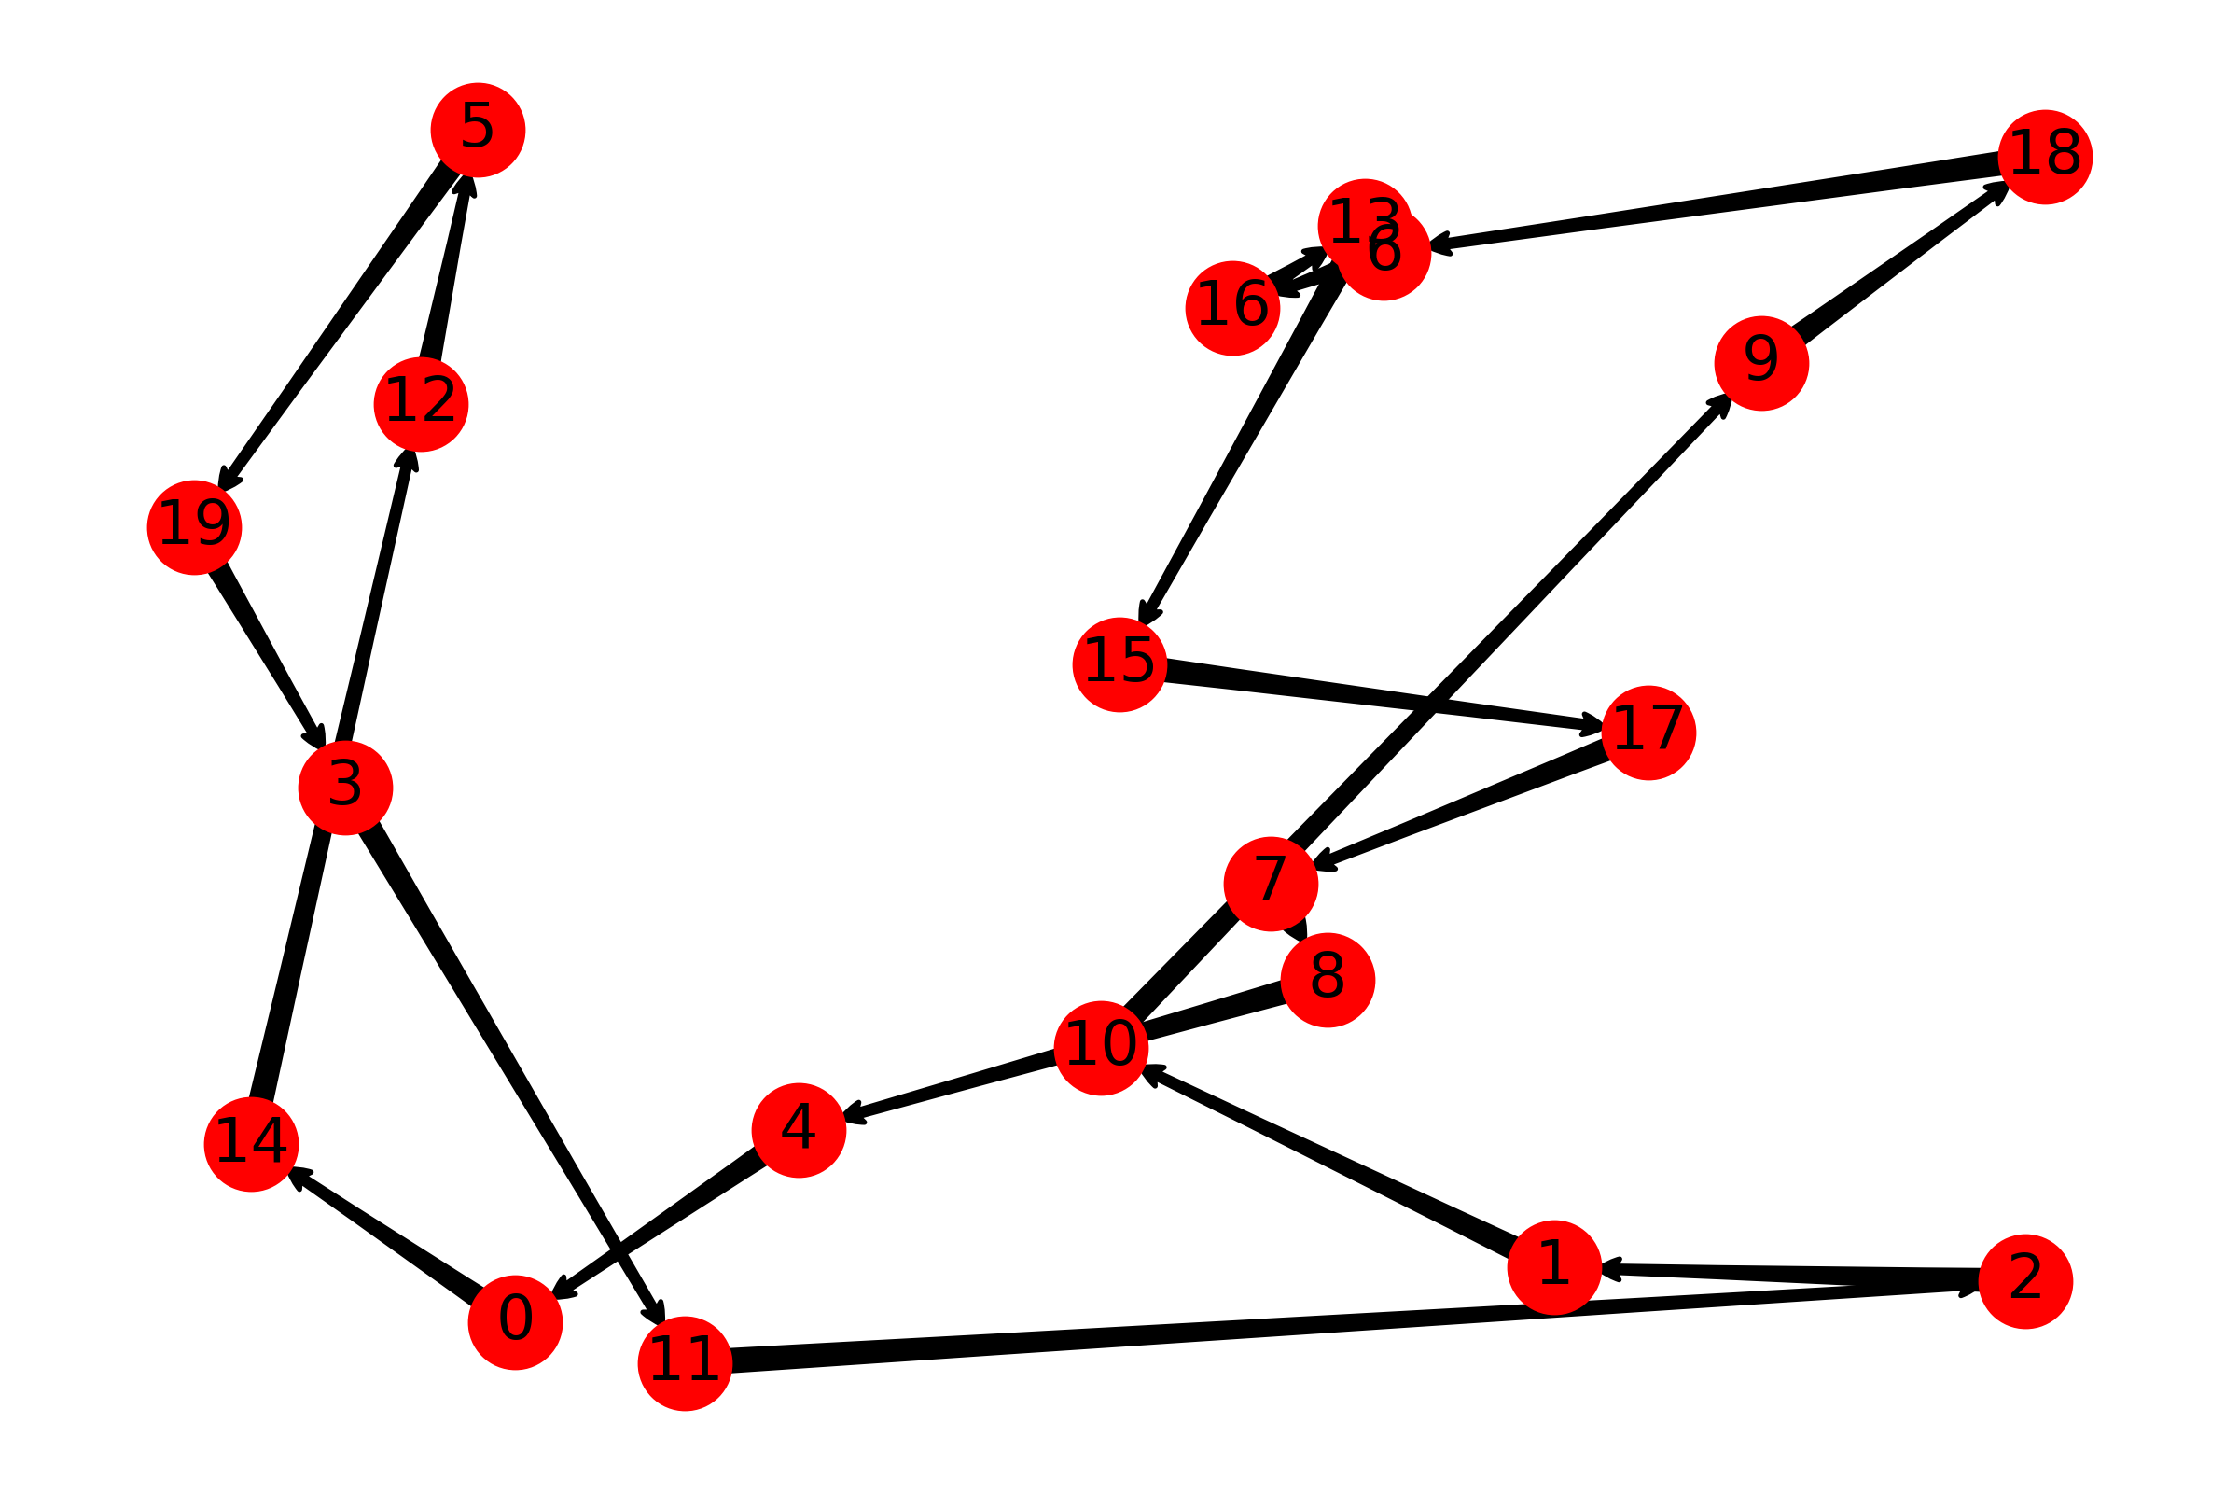
Experiment 1 Result
Epoch: 20
Distance:587.46

Slide 11
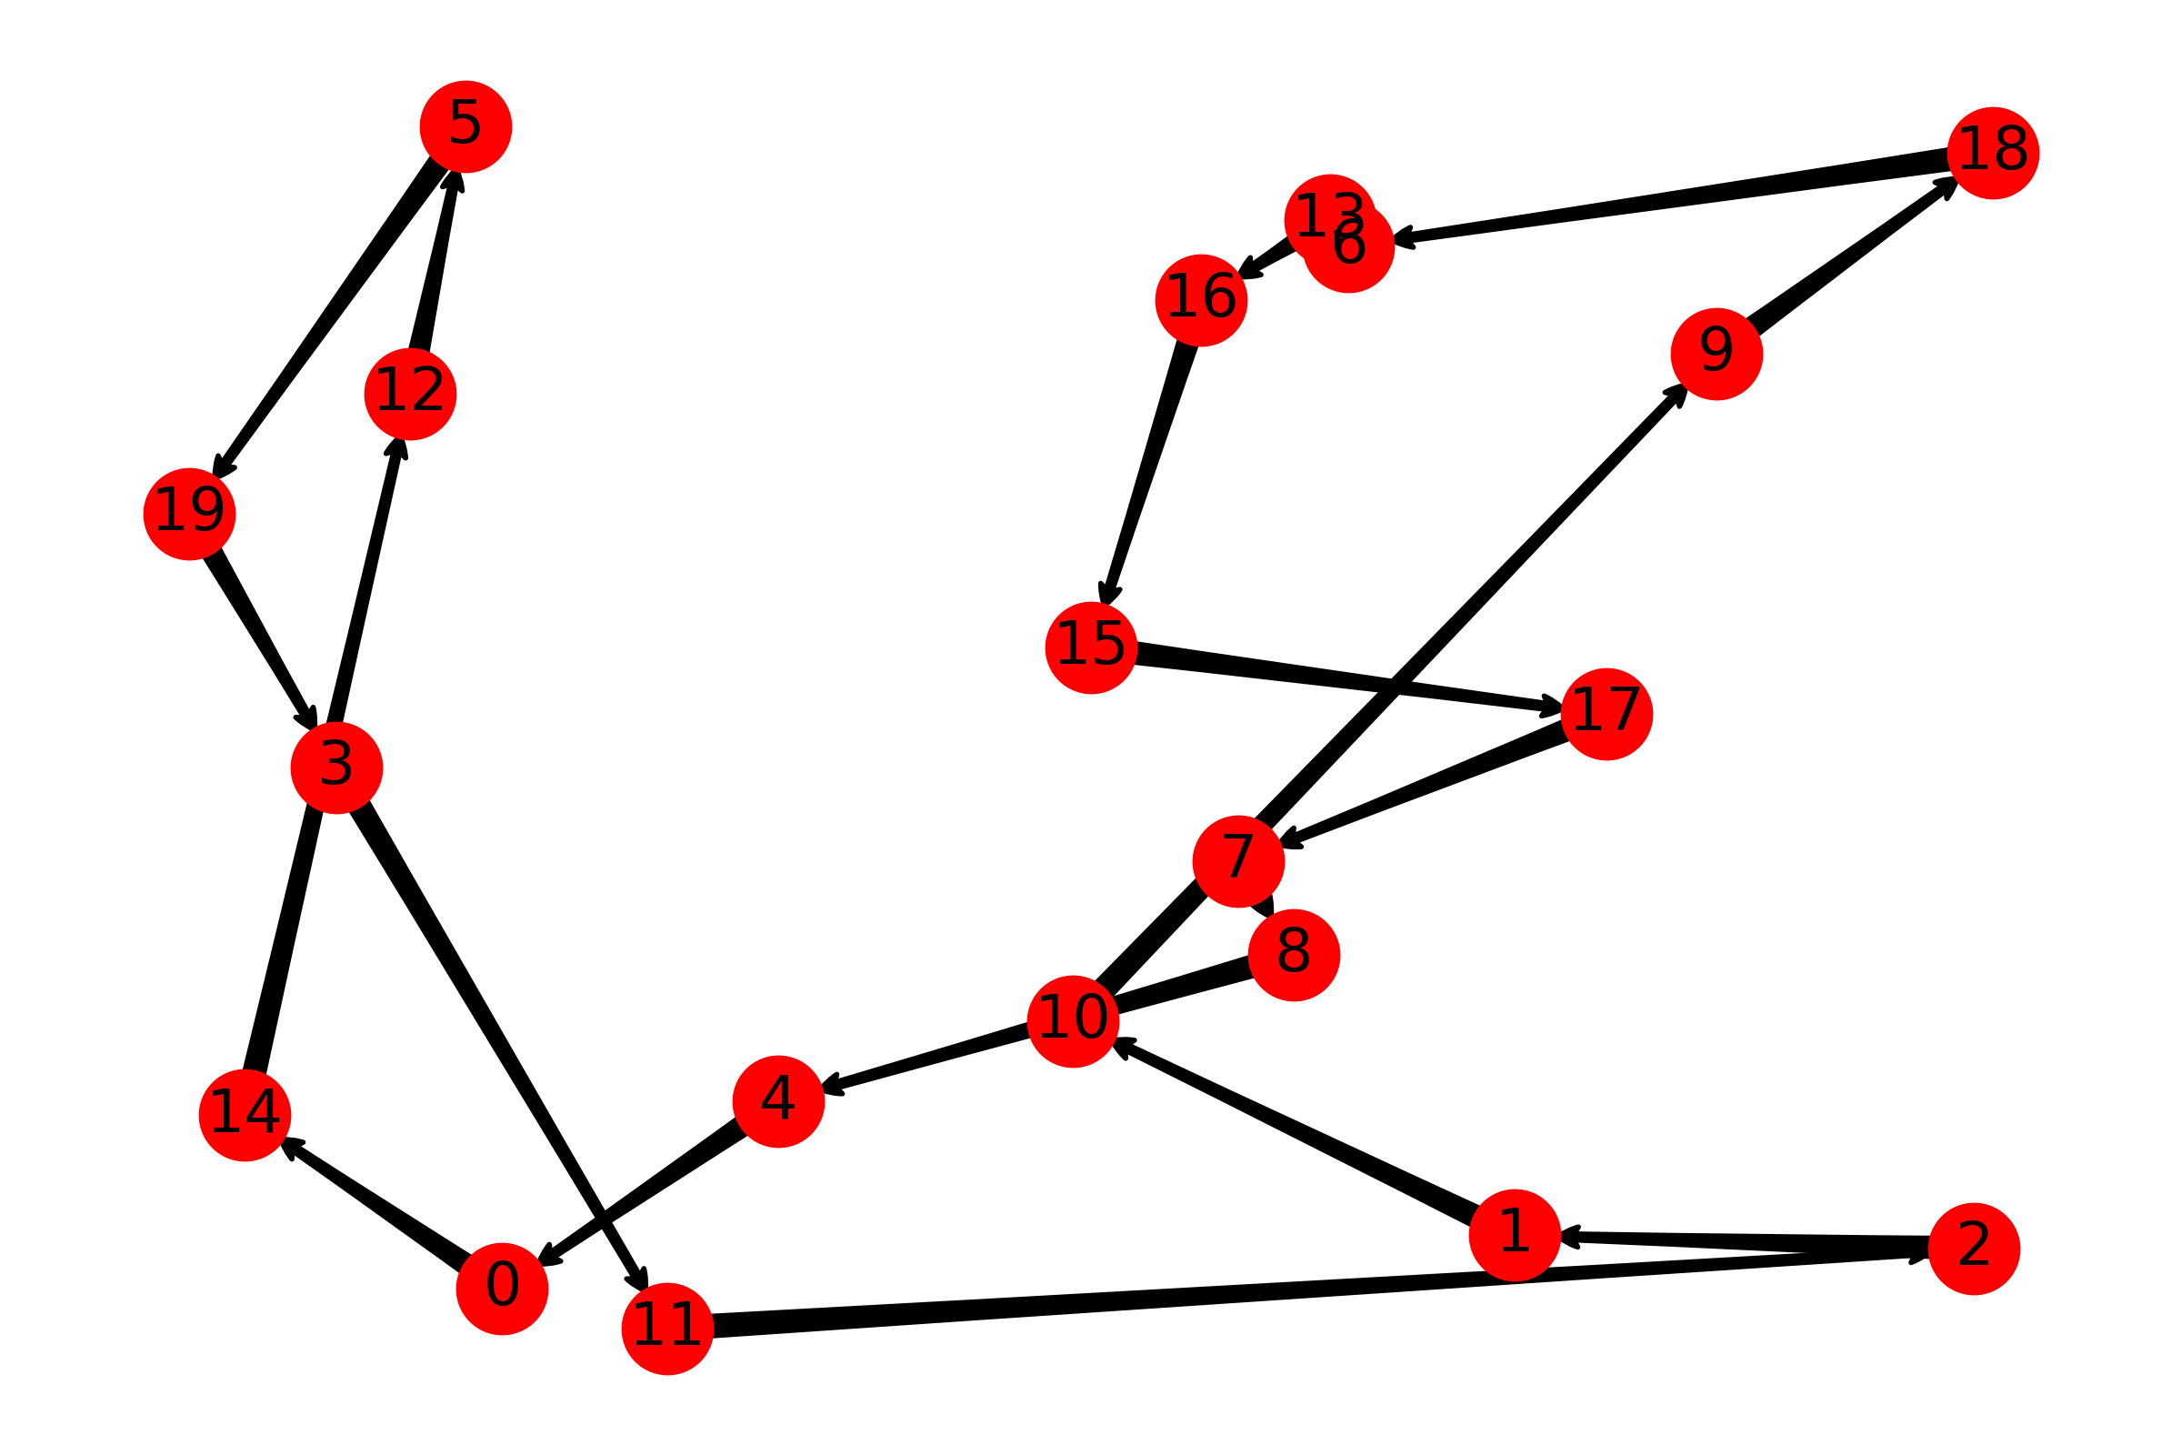
Experiment 1 Result
Epoch: 5000
Distance:572.90
Number of local update = 25
Number of global update = 1

Slide 12
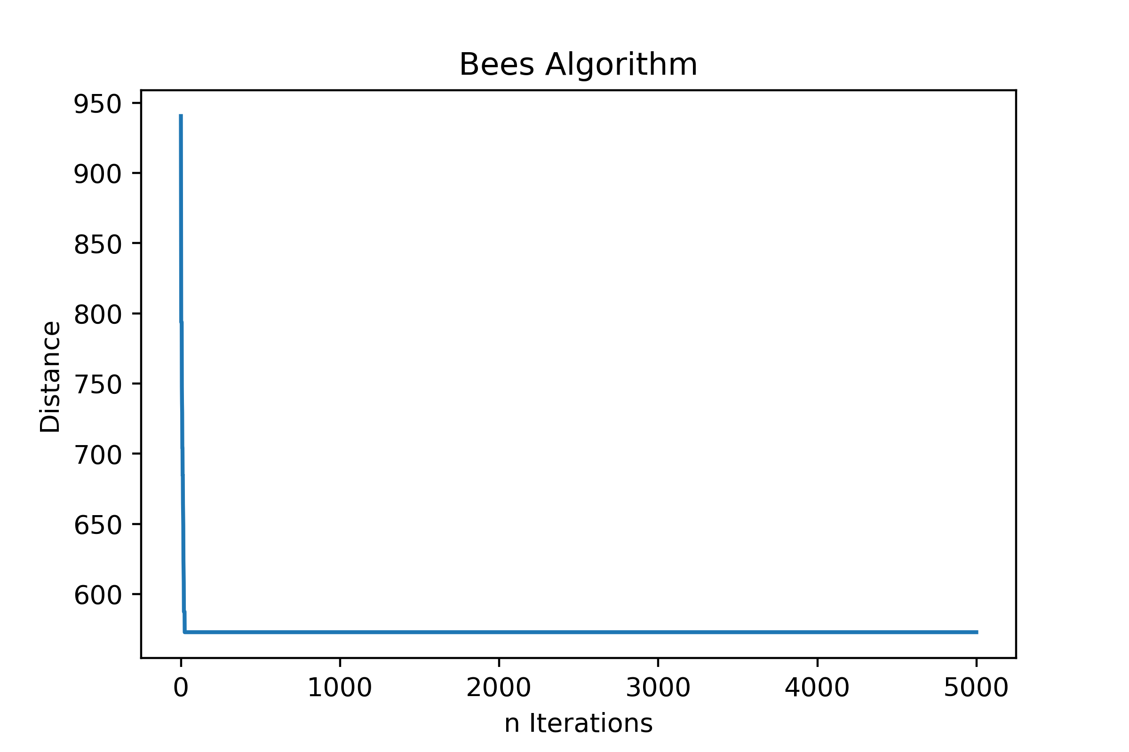
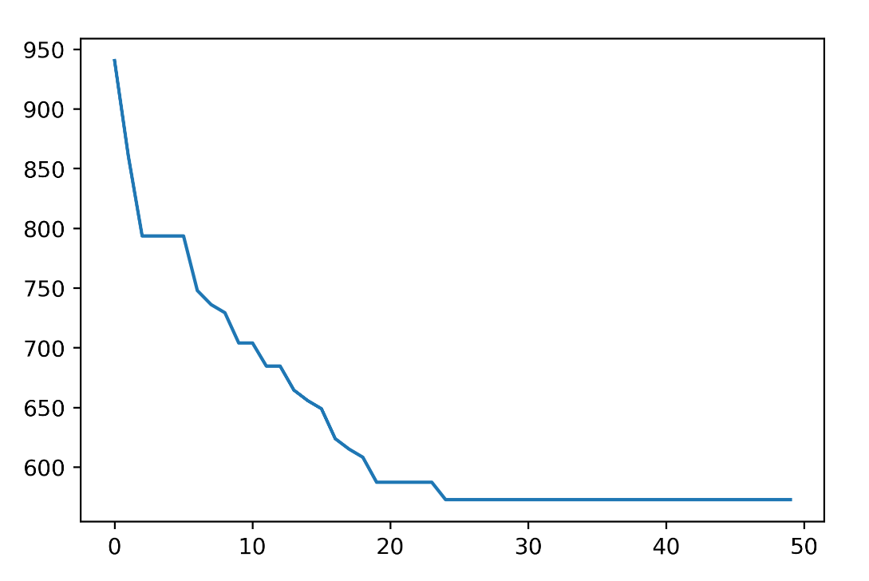
Experiment 1 Result
Converge to a solution really fast (<1000 iterations)
It is not the best path

Slide 13
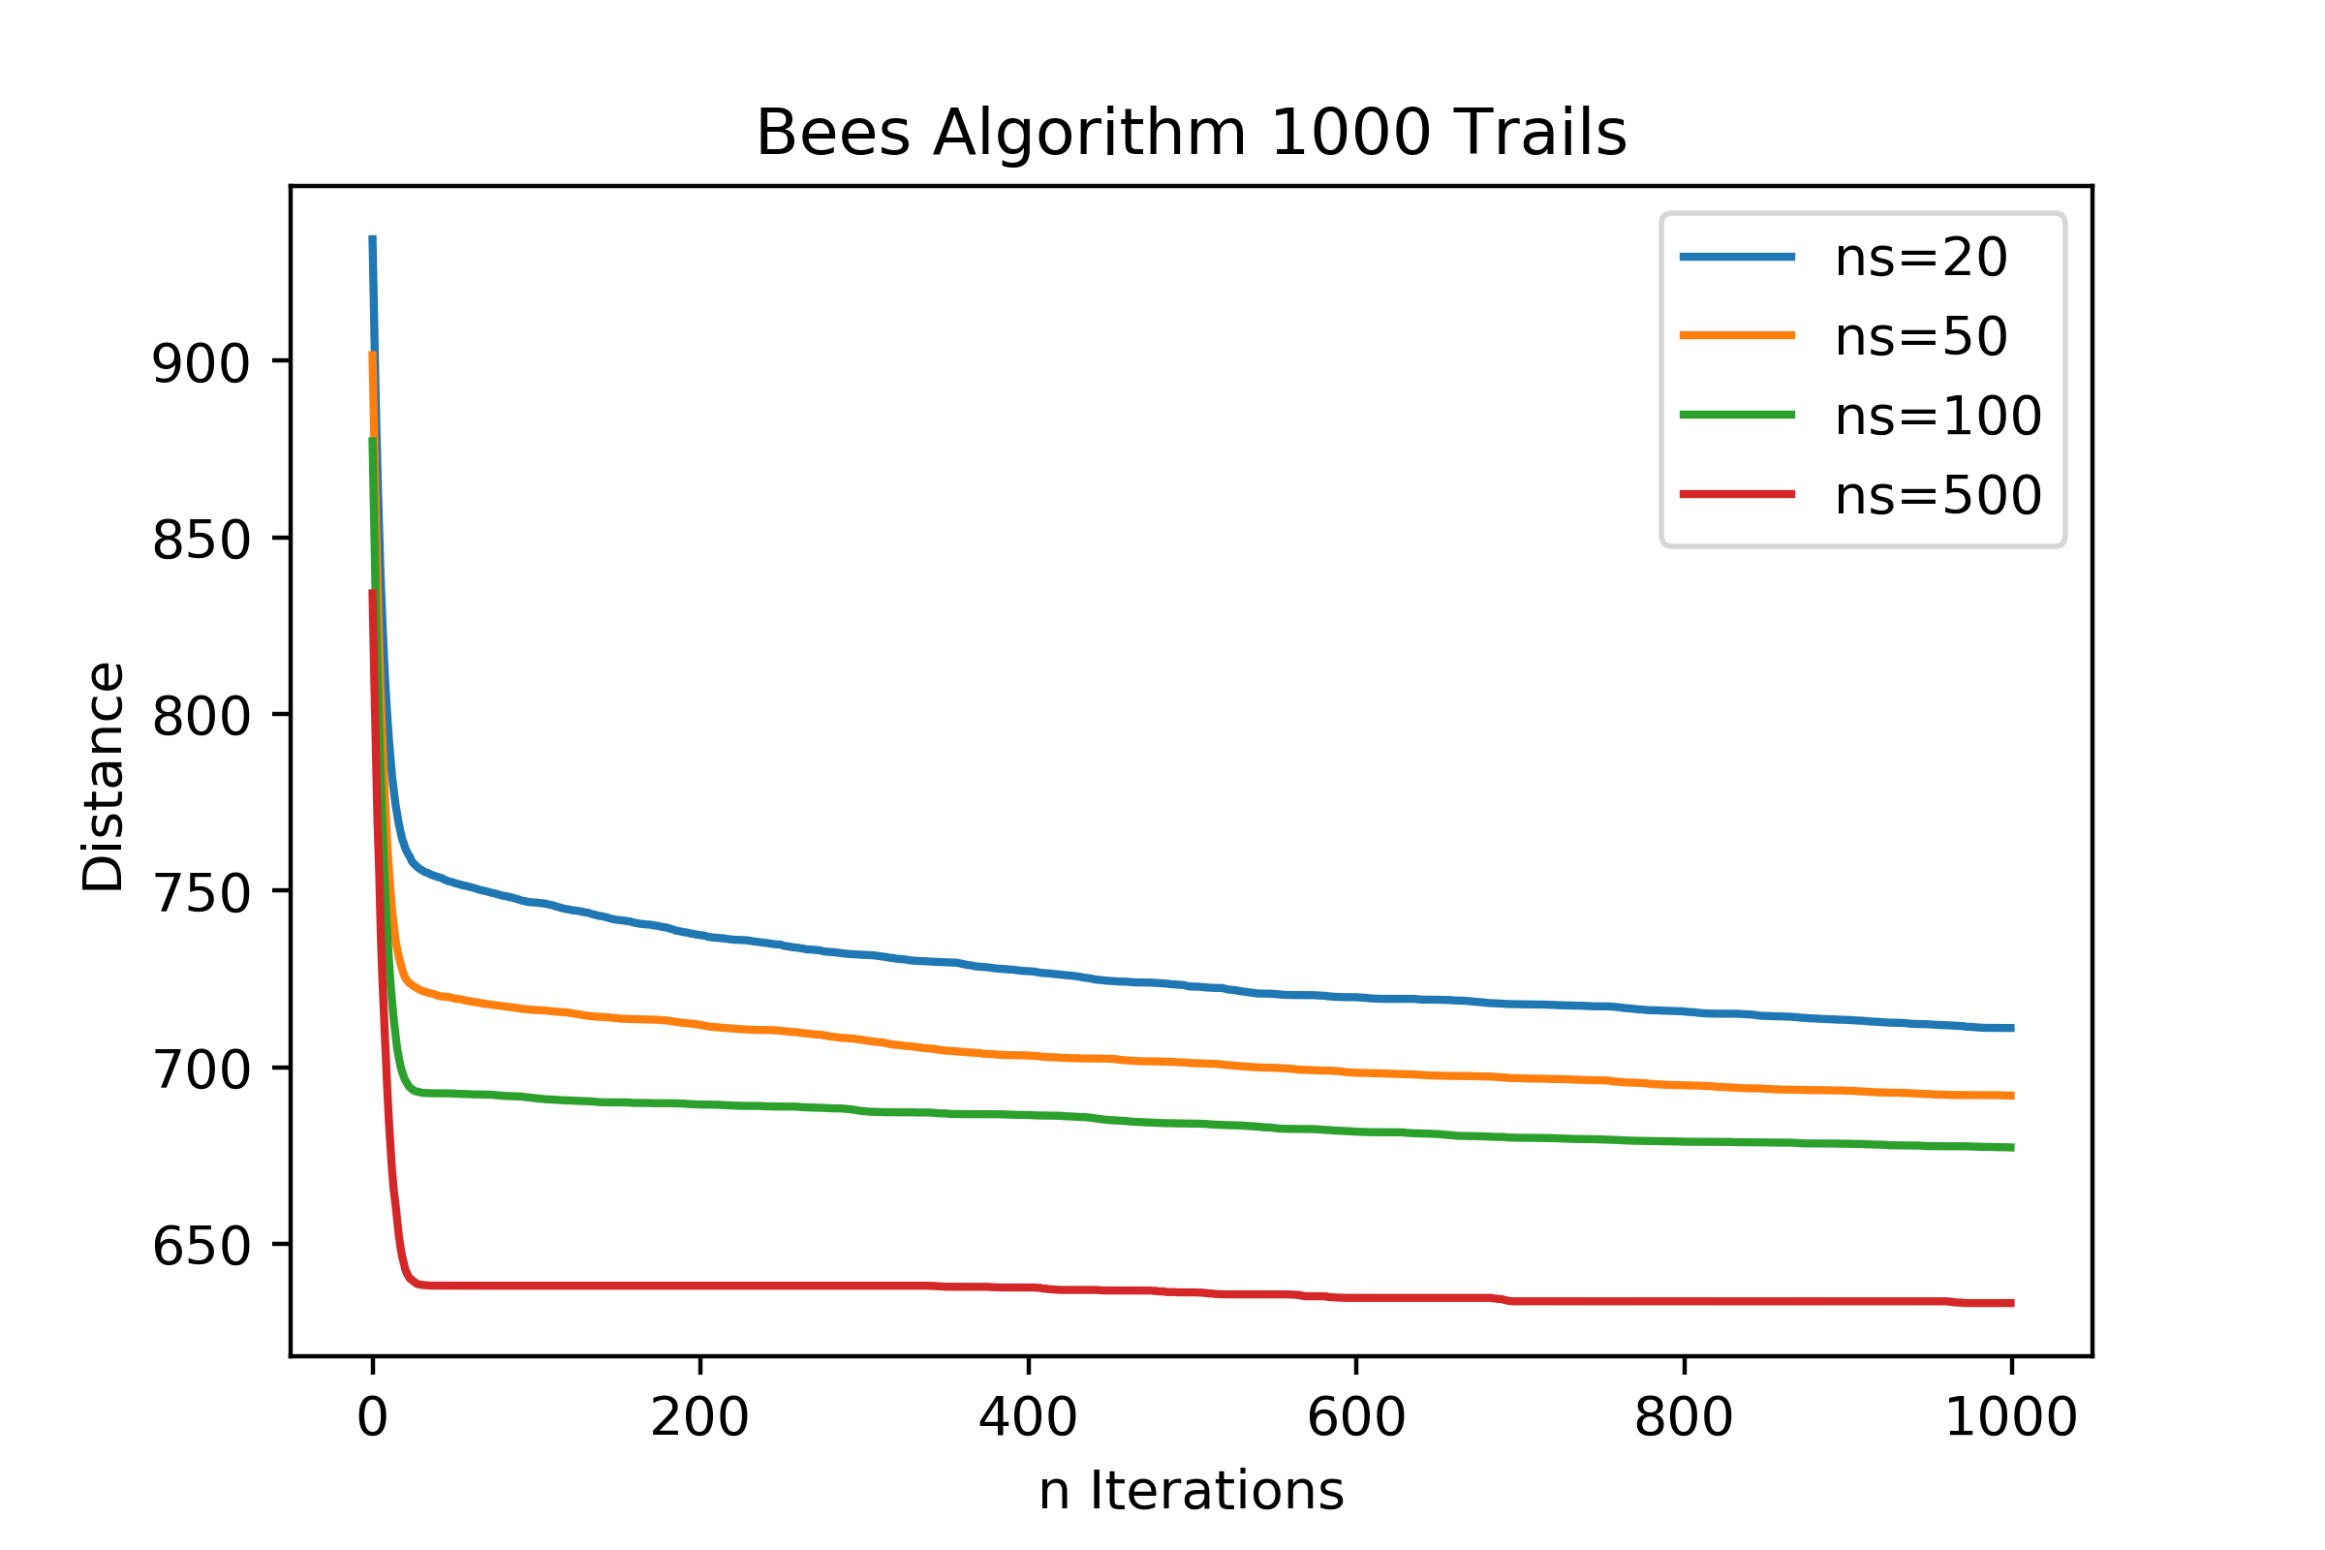
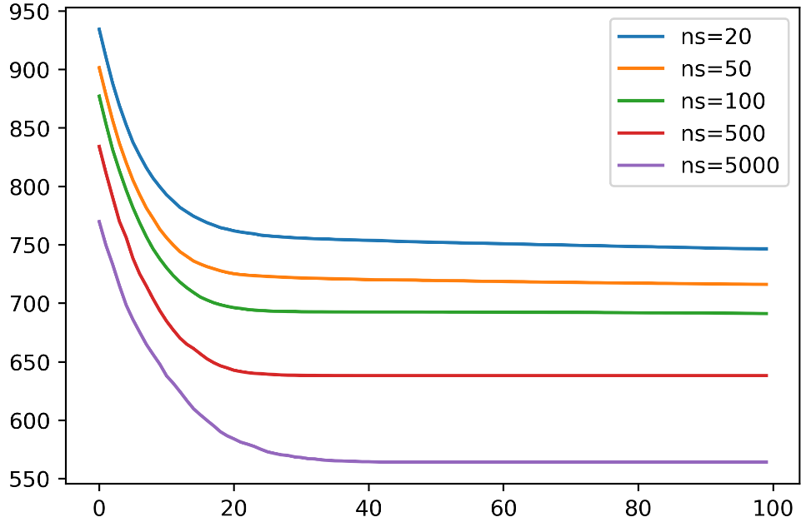
Experiment 1 Result
ns = 20,50,100,500
ne = int(ns * 0.2)
nre = 2
nb = int(ns * 0.5)
nrb = 1
max_epochs =1000
20!=2.433e+18
ns=20: 711.15
ns=50: 692.02
ns=100: 677.33
ns=500: 633.27
ns=5000: 564.19

Slide 14
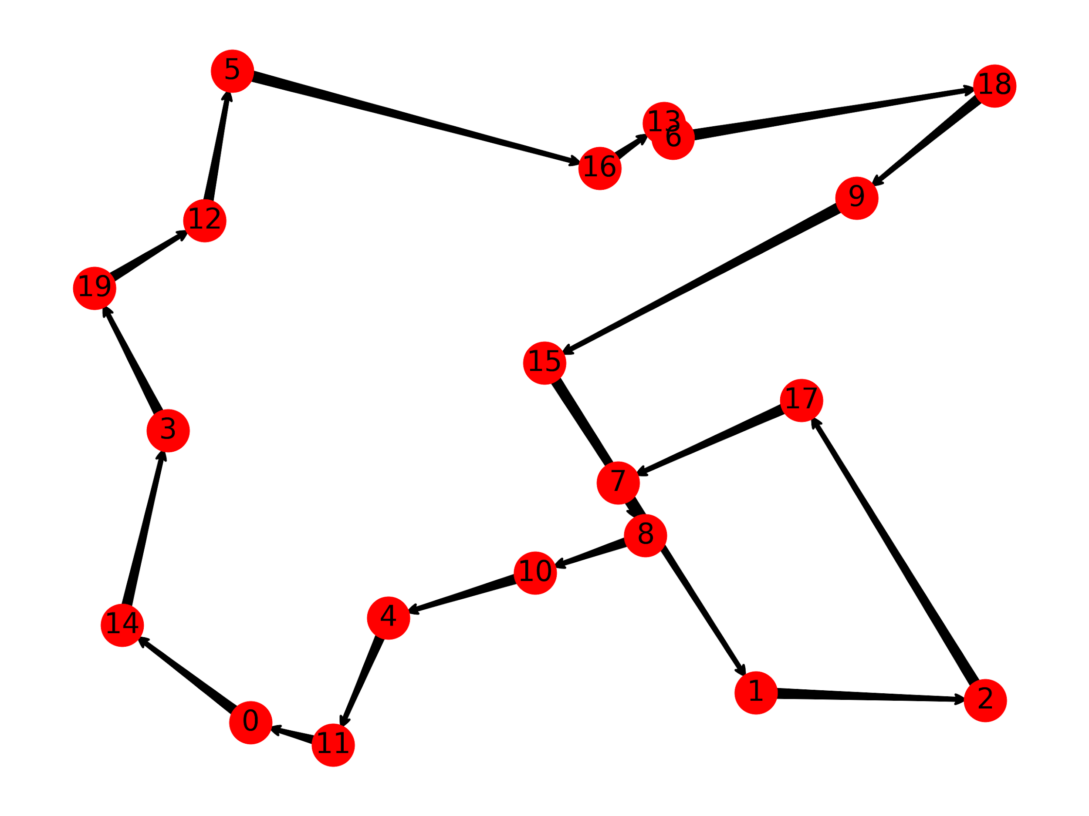
Experiment 1 Data
ns = 10000
ne = int(ns * 0.2)
nre = 2
nb = int(ns * 0.5)
nrb = 1
max_epochs =80
20!=2.433e+18
Epoch: 80
Distance:499.98

Slide 15
Experiment 2 Dataset
TSPLIB is a library of sample instances for the TSP problem
Test different datasets from TSPLIB
The size is from 29 to 202 cites

Slide 16
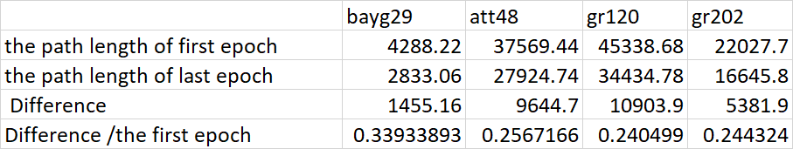
Experiment 2 result
Run 50 times for each dataset
The performance generally drops

Slide 17
Conclusion
In some limited time, find optimal better path
More bees, coverage to better results with a short time
The result is an optimal shortest path, and it is not the exact shortest
Future work
Use Bees Algorithm solve Vehicle Routing Problem
Update the profitability function, not just based on distance
Combine close cities to 1 node

Slide 18
Questions?

Slide 19
References
https://www.fastcompany.com/3062836/this-bee-inspired-algorithm-helps-delivery-companies-plan-the-most-effi
https://en.wikipedia.org/wiki/Bees_algorithm
http://beesalgorithmsite.altervista.org/
https://www.iwr.uni-heidelberg.de/groups/comopt/software/TSPLIB95/

